Slide 1
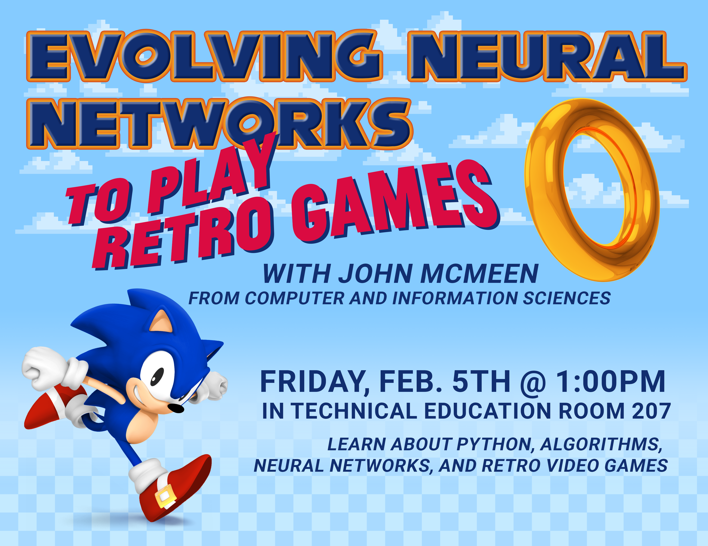

Slide 2
Overview
Machine Learning
NEAT
Retro Games
Open AI Gym Retro
Code Review

Slide 3
Machine Learning
Computer algorithms that learn through experience
Artificial intelligence
Model data through training or sample data
Supervised, unsupervised, reinforcement learning

Slide 4
NEAT
Neuroevolution of augmenting topologies
Genetic algorithm which evolves neural networks
Ken Stanley in 2002 while at The University of Texas at Austin
NEAT Python

Slide 5
R E T R O F U T U R E

Slide 6
Open AI Gym Retro
Open source, many existing game integrations
Creates emulated game environment with game loop
Adds functionality to examine emulator RAM (memory)

Slide 7
Code Review
Originally released by Lucas Thompson
Cleaned up and documented

Slide 8
Future Work
Adapt existing work to all games in Sega ROM Library
New integrations for Open AI Gym Retro
In house AI competitions

Slide 9
Questions
jnmcmeen@northeaststate.edu
Github:

Slide 10
Sources

